Slide 1


Best Practices of the Best Contractors

Slide 2
Introductions
Your name
How many years in the industry
What you do now
Short story about one of your experiences with leadership

Slide 3
Contractors who are short term successful, “Good Contractors”
Expanding market where show up is good enough
Bad leader with great field people, often happens in second generation companies
Great relationship with a growing customer
Fell into a niche
  Data Centers
  Hi-purity piping
  Fueling stations
  Service

Slide 4
What is the greatest enemy of the best?
THE GOOD

Slide 5
Level 5 leadership: Good to Great: Jim Collins
Level One: Highly capable individual
Level Two: Contributing team member
Level Three: Competent manager
Level Four: Effective leader
Level Five: Level 5 executive

Slide 6
Path to Level 5 Leadership
Level one:
  Highly capable individual, Makes productive contributions through talent, knowledge, skills, and good work habits.
Level two:
  Contributing team member, Contributes individual capabilities to the achievement of group objectives and works effectively with others in a group setting.

Slide 7
Path to Level 5 leadership
Level three:
  Competent Manager, Organizes people and resources toward the effective and efficient pursuit of pre-determined objectives.
Level four
  Effective Leader, Catalyzes commitment to and vigorous pursuit of a clear and compelling vision, stimulating higher performance standards.

Slide 8
Level 5 Leadership builds enduring greatness through a paradoxical blend of humility and professional will.
“ I never stopped trying to become qualified for the job.”

Slide 9
Level 5 Leaders Make Sure They Have the Right People: John Wooden
Not robots, “but rather individuals who were extremely well grounded in the correct fundamentals, who had good performance habits”.
“In basketball the team is formed when the basketball is shared. For great companies the ball is information, knowledge, experience, contacts, new ideas, & much more.”
“The main ingredient in stardom is the rest of the team”
“When everyone is thinking the same, no one is thinking”
“There was a sense of urgency in everything we did; not haste, not hurry, but hustle”

Slide 10
John Wooden Achievements
Won 10 NCAA championships, seven in a row, in a twelve year period from 1963 to 1975
Had a winning streak of 88 games in a row
Won 38 straight NCAA tournament games
Quit coaching because he felt the focus had become too much on him and not the team
Based his life and teaching on his pyramid of success
Emphasized character rather than winning

Slide 11
In your groups list up to ten things the best contractors do that are different, and then force rank the top five.

Slide 12
Quickness under control is the most valuable aspect of any sport. (or company!)
John Wooden

Slide 13
Rank their customers annually

Slide 14
Platinum Customer
Often negotiate work with you
You are their preferred provider
Your work with them is profitable
Their pay record is excellent
You often do design build work with them
Your relationship with this customer is one of the major reasons for your company’s success

Slide 15
Gold Customers
You are one of their preferred providers
Your work with them is profitable
Their pay record is good
They regularly need your services
They treat you fairly
The loss of this customer would significantly impact the company

Slide 16
Silver Customers
Their work is competitive
The contractors involved are competent
You can develop a reputation in this market
They try to drive you to the lowest price
Pay history may be inconsistent
Jobs with these customers are “targets of opportunity”

Slide 17
Lead Customers
Everybody else

Slide 18
Good companies practices
Use electronic take-off
Have a standard summary sheet
Production factors based on historical data
Formula for crediting fabrication savings during the estimate

Slide 19
Best Companies Practices
Know their markets and strengths, not everything to everybody
Have competitive market pricing on bid day they can reliably use for planning
Use modular/assembly methods for estimating and budgeting

Slide 20
Basic Estimating Review
With a complete design a detailed estimate is prepared either manually or using BIM
Historical data developed by company or industry
Job cost data for a similar project
Assembly estimating
Modular estimating

Slide 21
“Standard Estimate”
Platform used by most companies
Has high level of comfort
Most systems have internal safeguards to minimize errors
Can use pieces from each of the following methods
Does not lend itself well to budget estimating

Slide 22
Historical Data Developed by Company
Biggest hurdle is discipline
Requires agreement on how data will be accumulated
Becomes most valuable as similar projects are constructed over a period of time
Will require that company keeps data allowing it to budget subcontractors and vendors

Slide 23
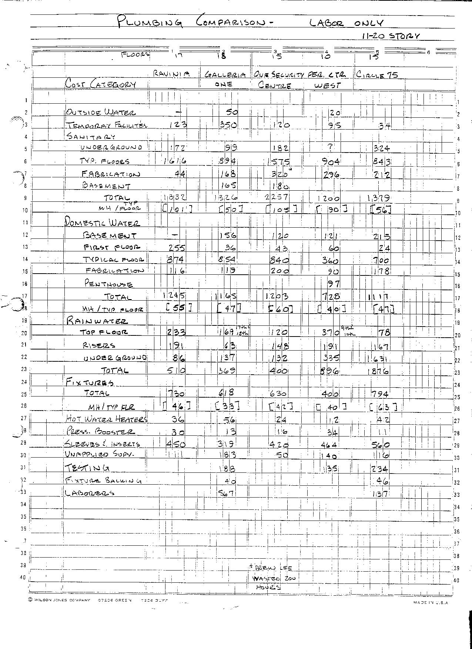
Plumbing Labor Cost

Slide 24
Assembly Estimating
Not used by many companies
Can work really well when variations of the assemblies are used in different combinations
Gives great discipline to the estimating and job costing systems
Benefits greatly from electronic purchasing

Slide 25
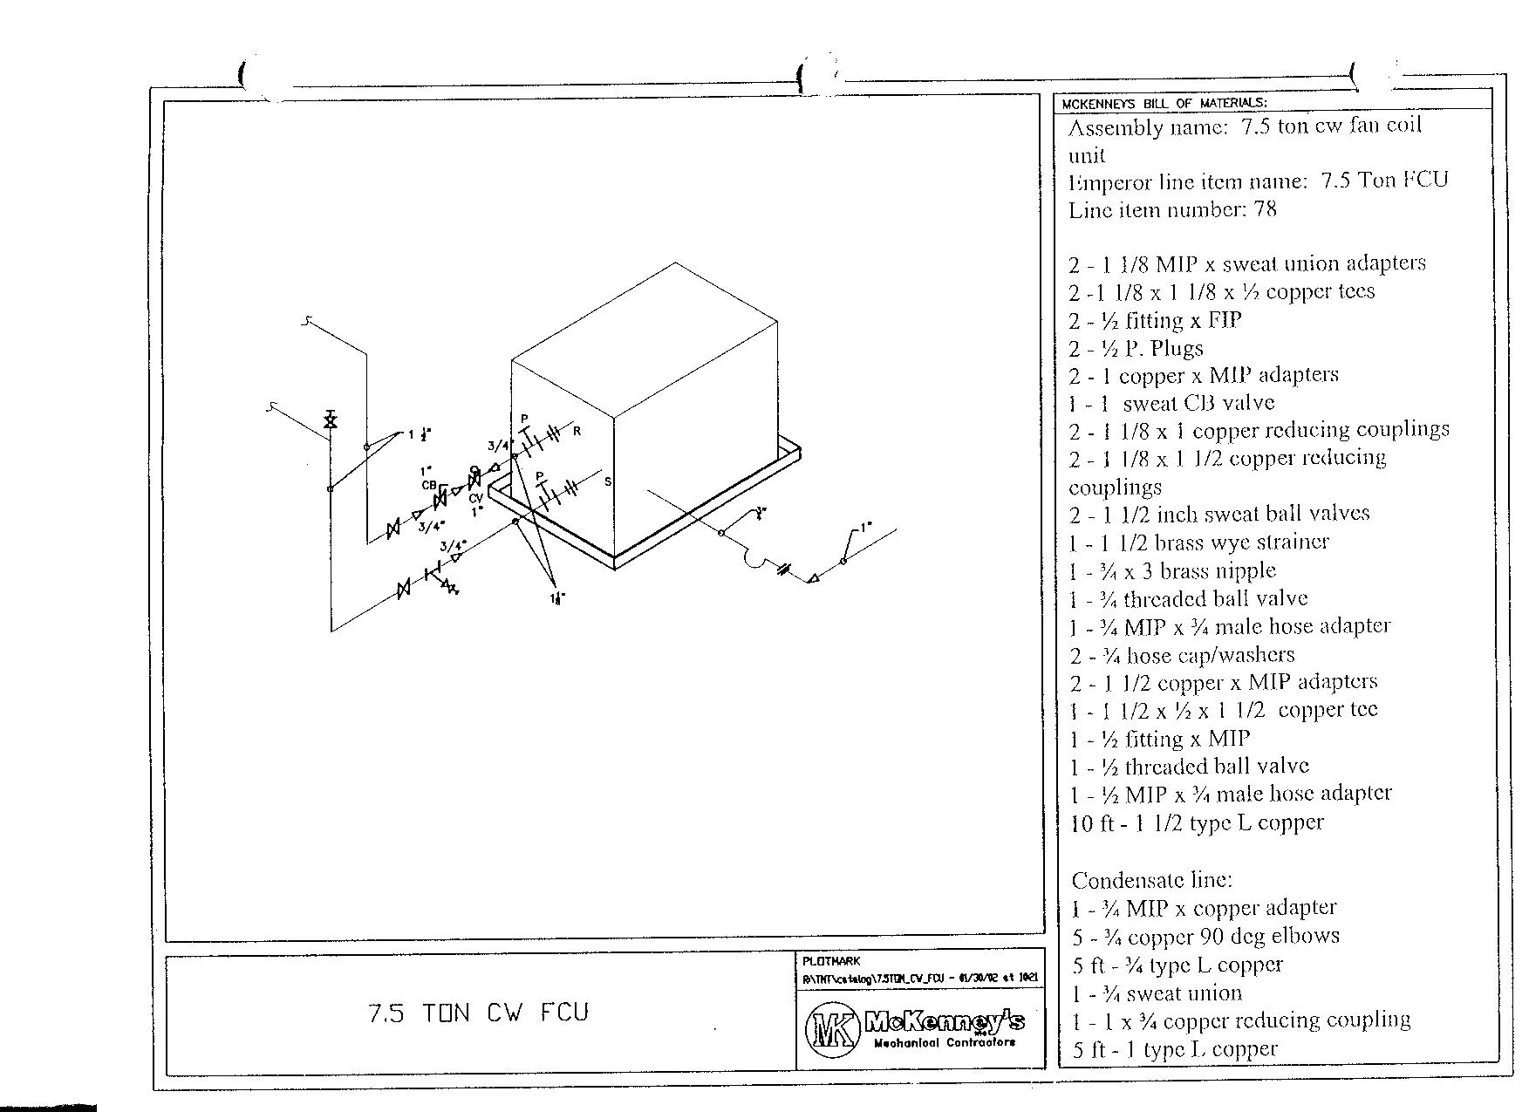
Typical Assembly

Slide 26
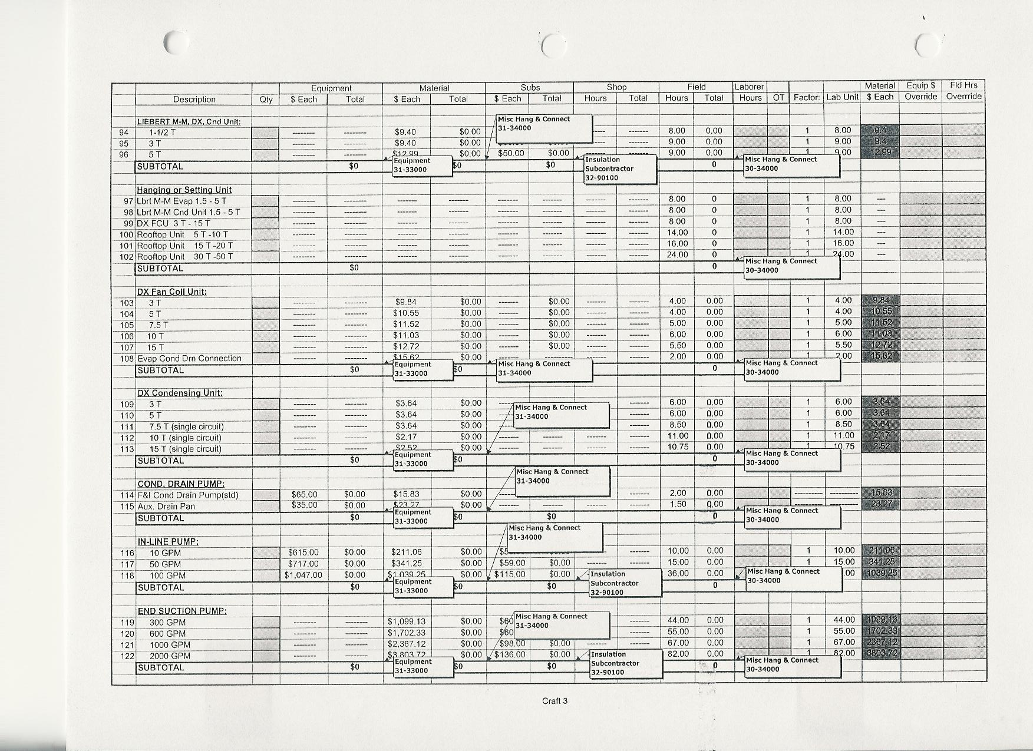
Estimating Form

Slide 27
Modular Estimating
Speed
Accuracy
Evolution of Estimating
Requires Discipline
Accurate and organized record keeping of historical data

Slide 28
Modular or Assembly
Estimating
VAV Box
VAV Box
VAV Box
VAV Box
VAV Box
VAV Box
Fan Powered Box
Fan Powered Box
Fan Powered Box
Fan Powered Box
Fan Powered Box
Cooling Tower
250 Ton Chiller
250 Ton Chiller
25 Hp
Pump Pair

Slide 29
Modular Estimating
Subcontractors
  Square Feet
  CFM
  Control Points
Job Expense
Mark Up
Final Summary
Proposal

Slide 31
Companies Sell It
Parametric Cost Estimating System
Means
McGraw Hill

Slide 32
Pre-Construction Planning
John Wooden
Solomon
When everyone is thinking the same, no one is thinking.
The most important key to achieving great success is to decide upon your goal and launch, get started, take action, move.
The devil is not in the details, success is in the details.
Any enterprise is built by wise planning, becomes strong through common sense, and profits wonderfully by keeping abreast of the facts.

Slide 33
Pre-Construction Planning
Jim Collins
David Allen
“few companies have a culture of discipline. When you have disciplined people, you don’t need hierarchy. When you have disciplined thought, you don’t need bureaucracy. When you have disciplined action, you don’t need excessive controls. When you combine a culture of discipline with an ethic of entrepreneurship, you get the magical alchemy of great performance.
“Simple, clear purpose and principles give rise to complex and intelligent behavior. Complex rules and regulations give rise to simple and stupid behavior. “
  Dee Hock

Slide 34
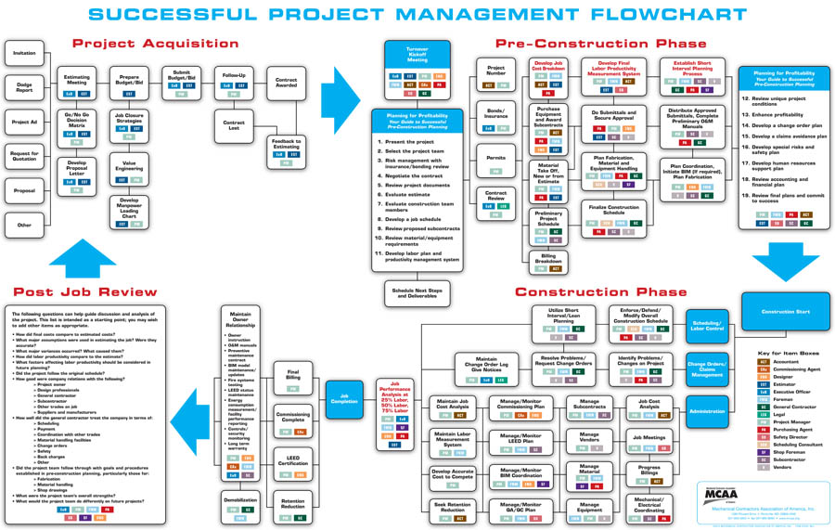

Slide 35
“A well organized leader can get more done in two hours than a poorly organized coach in two days.” Wooden

Slide 36
At your tables calculate the cost of a foreman, two journeymen, and two apprentices on an annual basis.

Slide 37
Pre-Construction Planning
Best companies, IT’S THE CULTURE
Templates for everything, job cost, material purchasing, writing subcontracts, planning fabrication, SIP
Do a manpower loading chart
Senior management is involved

Slide 38
Job Cost Template
Used for every job so that the process is clear and consistent
Labor is broken down into area specific labor loaded craft codes so that the productivity can be tracked and the foreman can “own” the activity
The estimate is pulled together in the same form as the job cost will be tracked
Same form allows you to use “Big Data”

Slide 39
The Devil is not in the details, SUCCESS is in the details
John Wooden

Slide 40
Other Templates
Submittal/Equipment tracking
Equipment purchasing
Subcontract purchasing
RFI Logs
Change Order form
Change Order logs
Others?

Slide 41
Anticipation of Problems Activities
Electronic purchasing
  Done annually or as often as necessary
  Vendor does the pricing creating the intelligent electronic entry
  List can come from BIM, standard assemblies, field, shop, etc
  Vendor fills order and invoices with proof of delivery
  Purchasing is done by system to allow comparison to estimate
Design Constructability Review
  Contractor refuses to knowingly build something that will not work

Slide 42
Too many companies don’t handle problems when they come up, they handle problems when they blow up.

Slide 43
Construction Building Blocks
Foreman drives the show
  Is involved with pre-construction planning
  Develops the SIP plan (three week look ahead) with the project manager
  Foreman has skin in the game
  Foreman has all the information necessary, weekly cost reports, delivery information, RFI status, change order status, etc
  Foreman controls the quality of the tools
  Best foremen mentor the next generation of leaders

Slide 44
Company Philosophy
We will sort of do what we said we would do, kind of like we said we would do it, close to when we said we would do it _ maybe.
We will do what we said we would do, as we said we would do it, when we said we would do it_ period.

Slide 45
In your groups calculate the money lost by the previous crew opening a dis-organized gang box

Slide 46
Construction
John Wooden
Peter Drucker
If you get caught up in things over which you have no control, it will adversely affect those things over which you have control.
The knowledge that we consider knowledge proves itself in action. What we now mean by knowledge is information in action, information focused on results.

Slide 47
Company Keeps the Customer Informed During the Construction Period
Short Interval Plans shared with owner and general contractor
Change Order Logs attached to billings
RFI logs actively managed
Often send a “job report” with the billing
When problems occur, contractor informs owner of risks and costs BEFORE the money is spent

Slide 48
Management Stays Involved with the Project
Job cost reviewed monthly using metrics to flag problems
Monthly does not mean monthly WIP meetings which if necessary are an indictment of the quality of the job cost reporting system
Upper management is committed to the 25-50-75% reviews or some other scheduled method
Upper management or the owner or a marketing person regularly takes the “pulse” of the best customers

Slide 49
Post Job Reviews
Is part of the continuing education of the estimators and how they get recognized for their important contribution
Closes the loop
Can be a driver for when bonuses are paid
Allows you to replicate successes
Educates the company on how to recognize the early warning signs of a project that is not performing

Slide 50
In your groups identify the five best practices for you to implement

Slide 51
Bibliography
“Wooden on Leadership” : John Wooden
“Getting Things Done, The Art of Stress Free Productivity” : David Allen
“Good to Great, Why some companies make the leap, and others don’t”: Jim Collins

